Slide 1



DENTAJOT

Slide 2


TEAM MEMBERS
Abdullah Aljuraysi
Leader
Reef Alhesayni
Hessah Almulhim
Maha AlTamim

Slide 3




INTRODUCTION
Have you ever been to a dentist before?
Certainly, yes.
But do you remember everything that was done to your teeth?
Most likely not.
Simply put, our app allows you to track and record all the dental procedures performed on each of your teeth, helping you remember them all and saving time, effort, and money in trying to recall them.

Slide 4






SOFTWARE ENVIRONMENT
Figma
Github
Postman
Supabase
Flutter
Figma
Github
Postman
Supabase
Flutter
Figma

Slide 5


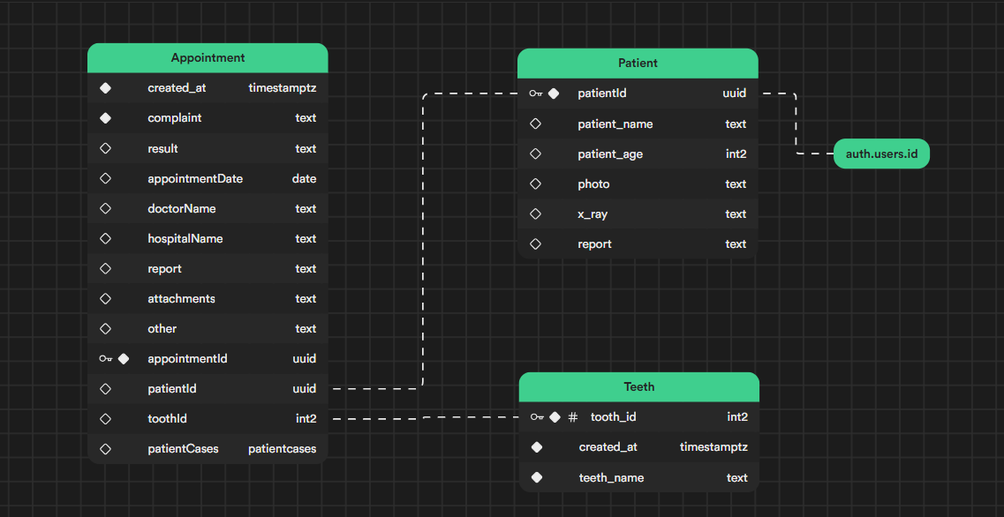
DIAGRAM

Slide 6
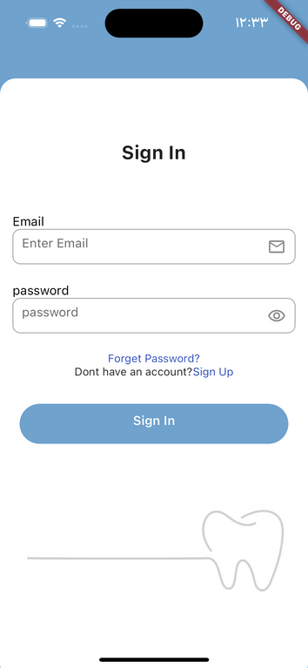
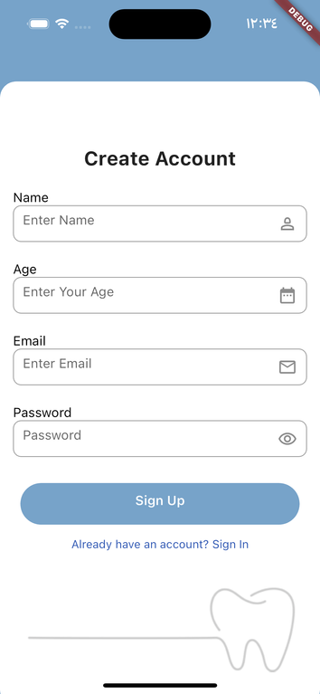
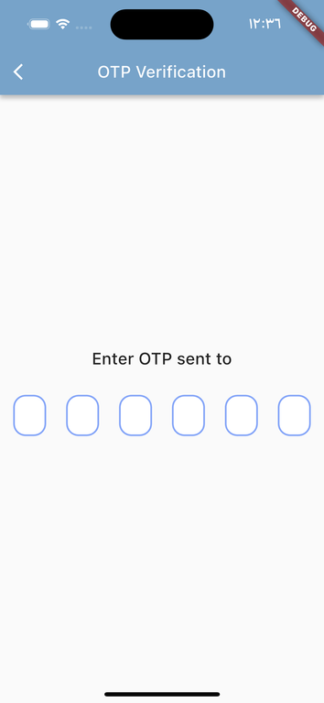
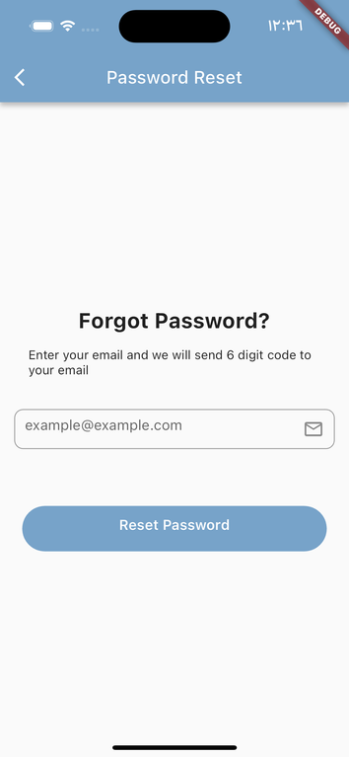

AUTH SCREEN

Slide 7
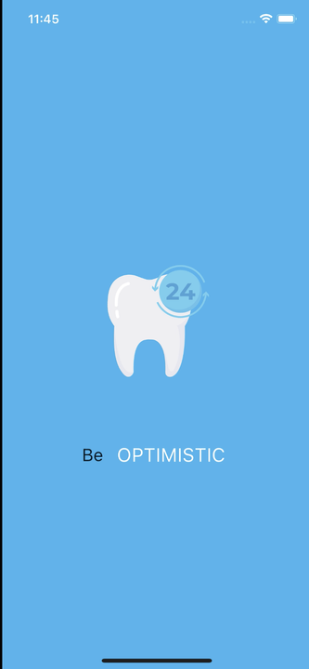
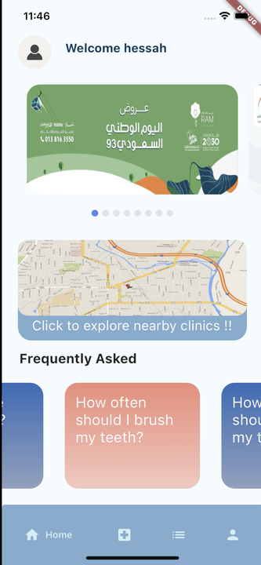
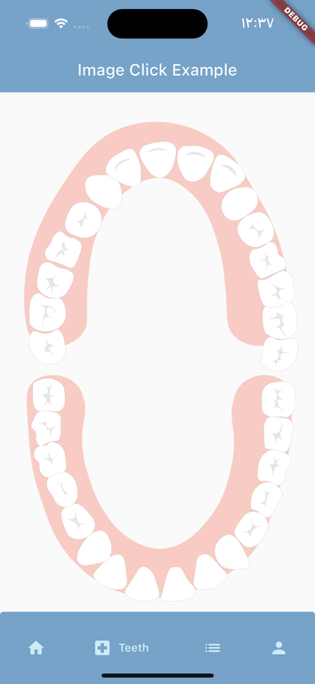
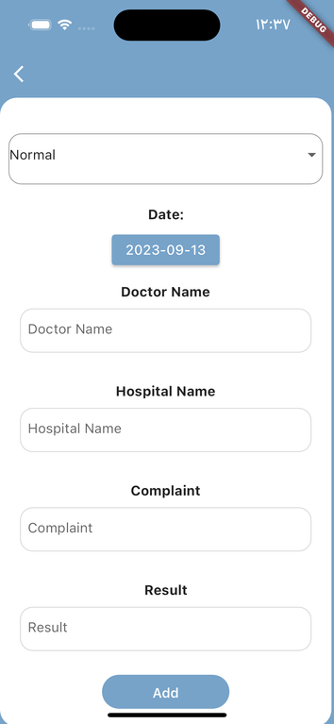
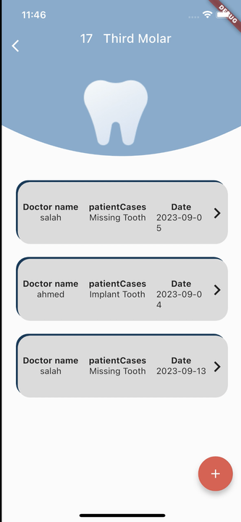
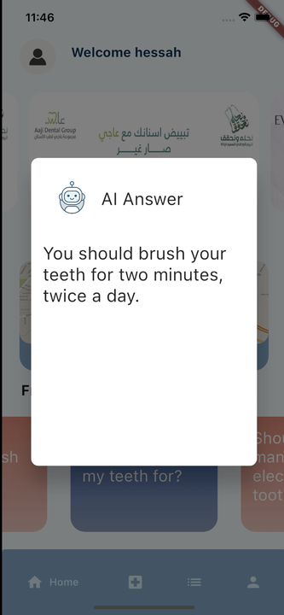
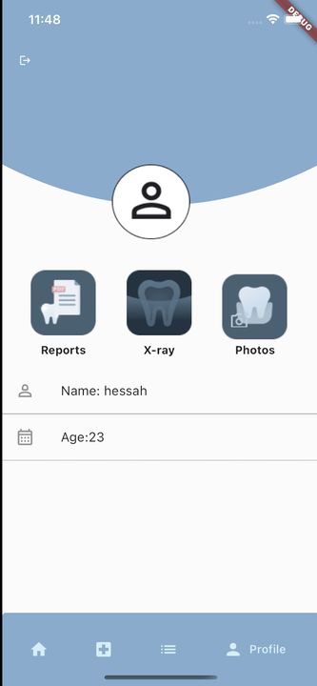
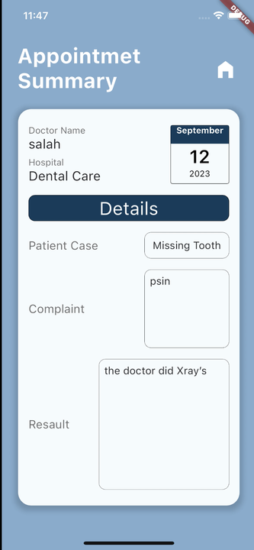
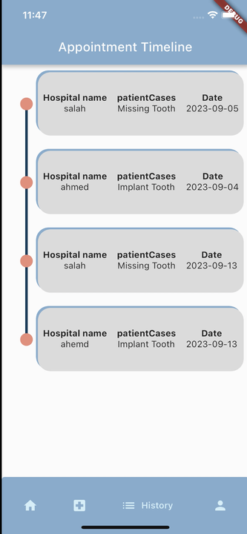
APP SCREEN

Slide 8

FUTURE PLANS
More Languages
Integration with Dentist
Feedback and User Surveys
Community

